Slide 1

Covid-19 Severe Outcome Risk Prediction
Changrong Ji
Dr. Mahesh Shukla
Dr. David Patton
Dr. Xue Yang
Dr. Xingguo Zhang
Antonio Linari
Premdutt Gaur
Vance Degen
A3.AI
Private Machine Learning on Medical Records & Social Data

Slide 2
Multiple research aims are addressed in detail in the following papers respectively:
Predicting Risk of Hospitalization among COVID-19 Patients, Mahesh Shukla, et.al.
Social Determinants of Health for COVID-19 Diagnosed Patients, David Patton, et.al.
Privacy-Preserving Machine Learning Techniques 2020, Changrong Ji, et.al.
Study Plan: Building Clinical Concept Embeddings under Computing Resource Constraints, Antonio Liniari, et.al.

Slide 3

Topics
About Us
Aims
Data
Approach
Early Findings
Future Work

Slide 4
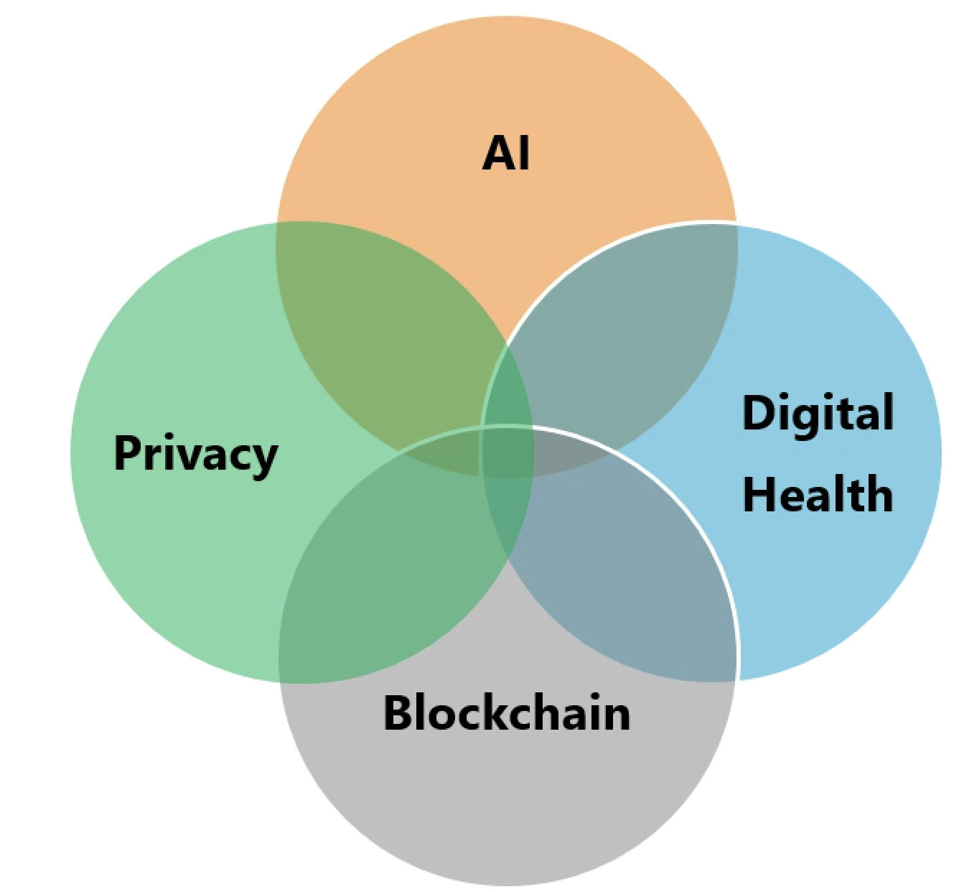
Nonprofit Applied R&D
We are:
Data Scientists
Physicians
Engineers
Advocates
Researchers
Privacy Specialists
Game Developer
Venture & Social Capitalist
A3.AI

Slide 5
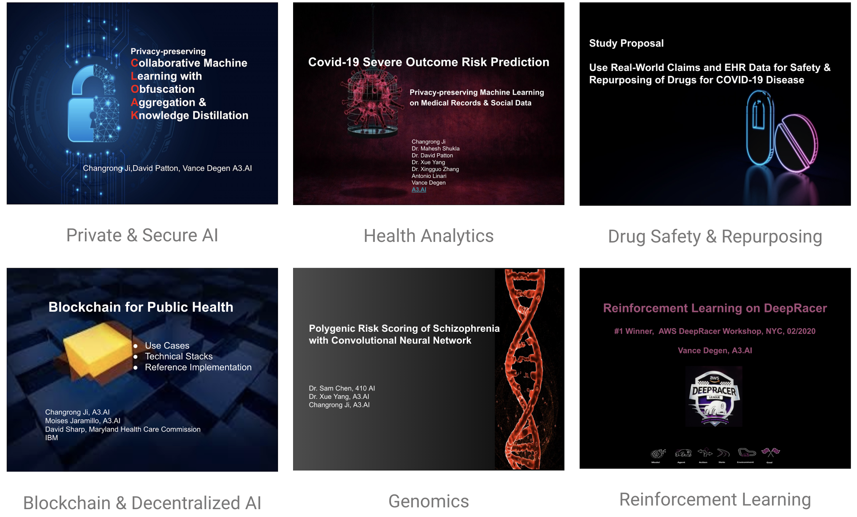
Projects

Slide 6

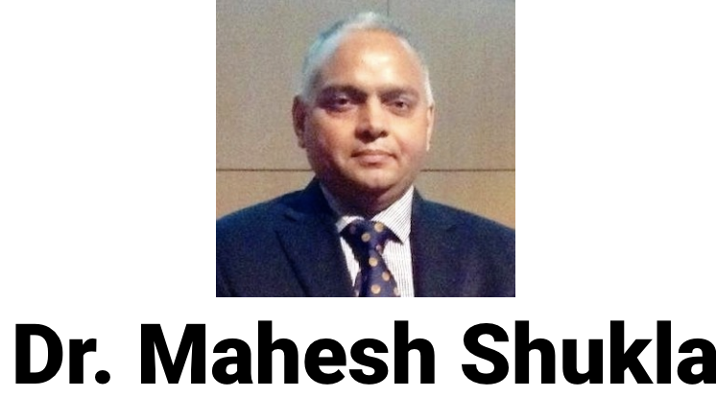


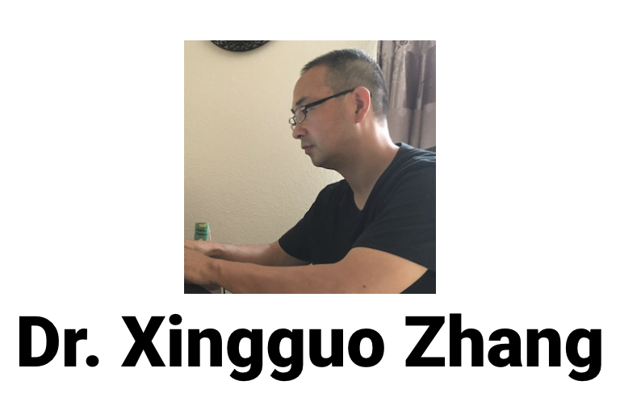


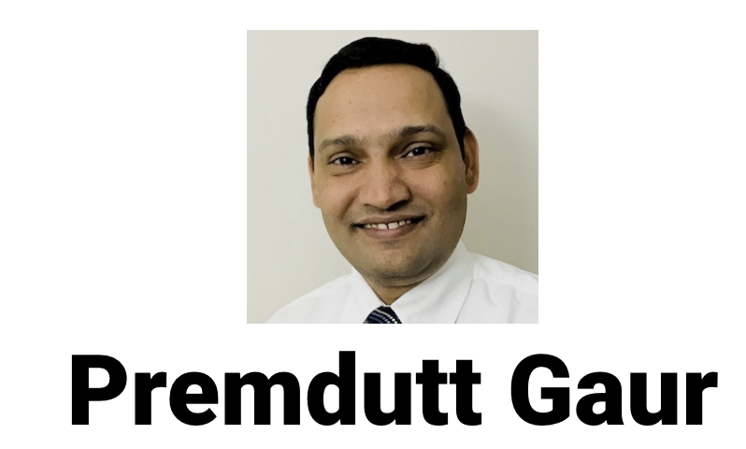

COVID-19 Project Team
The data, technology, and services used in the generation of these research findings were generously supplied pro bono by the COVID-19 Research Database partners
https://covid19researchdatabase.org/

Slide 7
Aims
COVID-19 Severe Outcome Risk Prediction
Social Determinants of Health and Risk Factors of COVID-19
Privacy-preserving Machine Learning
Building Clinical Concept Embeddings under Computing Resource Constraints

Slide 8
Data
As of 08/21/2020, with new data added with 1 week delay
Claims
98 million patients 7 years of medical claims history of over 3 billion claim lines
Key attributes: ICD diagnosis codes, CPT procedure codes
200,000+ COVID patients
Electronic Health Record (Outpatient)
36 million patient’s outpatient EHR records;
Diagnoses, Procedures; Encounters, Medications; Allergy, Social History, etc.
16,000 confirmed COVID patients , and 75,000 possible COVID patients
Social - Claims - Death linked
242 million people’s Social Data
People (demographics, finance, credit, housing, jobs, lifestyle)
Behaviors (interests, purchasing, social network activity, charitable giving, health lifestyle)
Predictors (motivator, travel, auto, in-market, and economic stats)
Death Registry of 80% of US population
Died_in_2020
95,000 COVID patients

Slide 9
Attributions to Data Providers
AnalyticsIQ
AnalyticsIQ is s a leading predictive data and analytics innovator that leverages a blend of publicly available data and custom algorithms informed by cognitive psychology concepts to describe consumers across three areas - People, Behaviors, and Predictors. Headquartered in Atlanta and recently named one of Georgia’s Top 10 most innovative companies, AnalyticsIQ’s team of data analysts, scientists, and cognitive psychologists have over 100 years of collective analytical experience and expertise.
Health Jump
Electronic Health Record data including diagnosis, procedures, labs, vitals, medications and histories sourced from participating members of the Healthjump network.
De-identified claims data was contributed by a claims clearinghouse.

Slide 10

Machine Learning for Clinical Prognosis

Slide 11
Aim 1
Create machine learning models to predict a patient’s risk of severe clinical outcomes if infected with COVID-19.
Hospitalization
ICU
Intubation
Ventilation
ECMO (heart-lung bypass)
Death, etc
These personalized risk scores and associated risk factors analysis can
Help citizens make informed work and lifestyle choices
Augment clinical prognosis by physicians
Help health care organizations coordinate care and optimize resources
Help public health agencies with planning, responding and reopening.

Slide 12
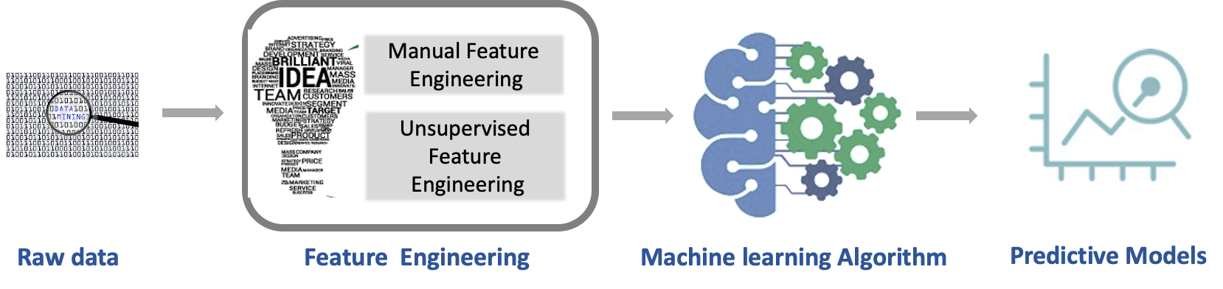
ML Model Development

Slide 13
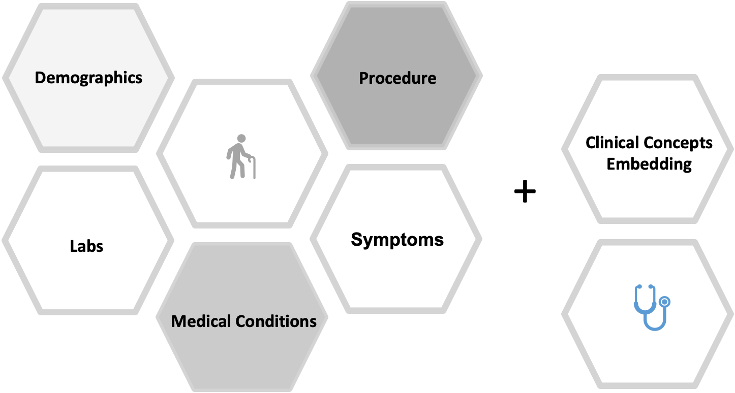
Feature Engineering

Slide 14
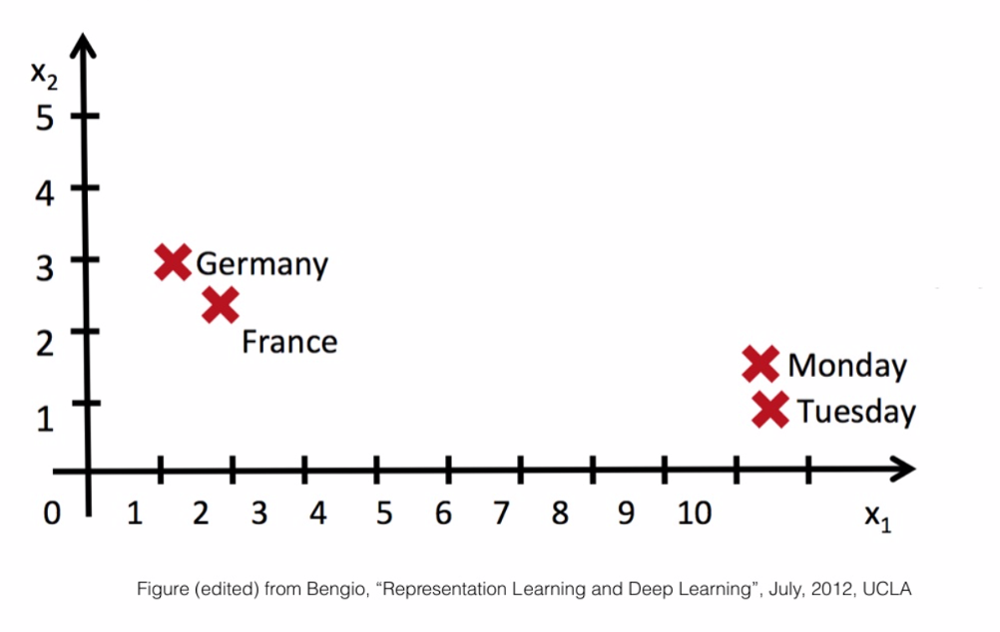
Embedding in NLP
Lower-dimensional space:
Words of similar meaning are located near each other in the embedded vector
Relative location of two words in the space could encode a meaningful relationship

Slide 15
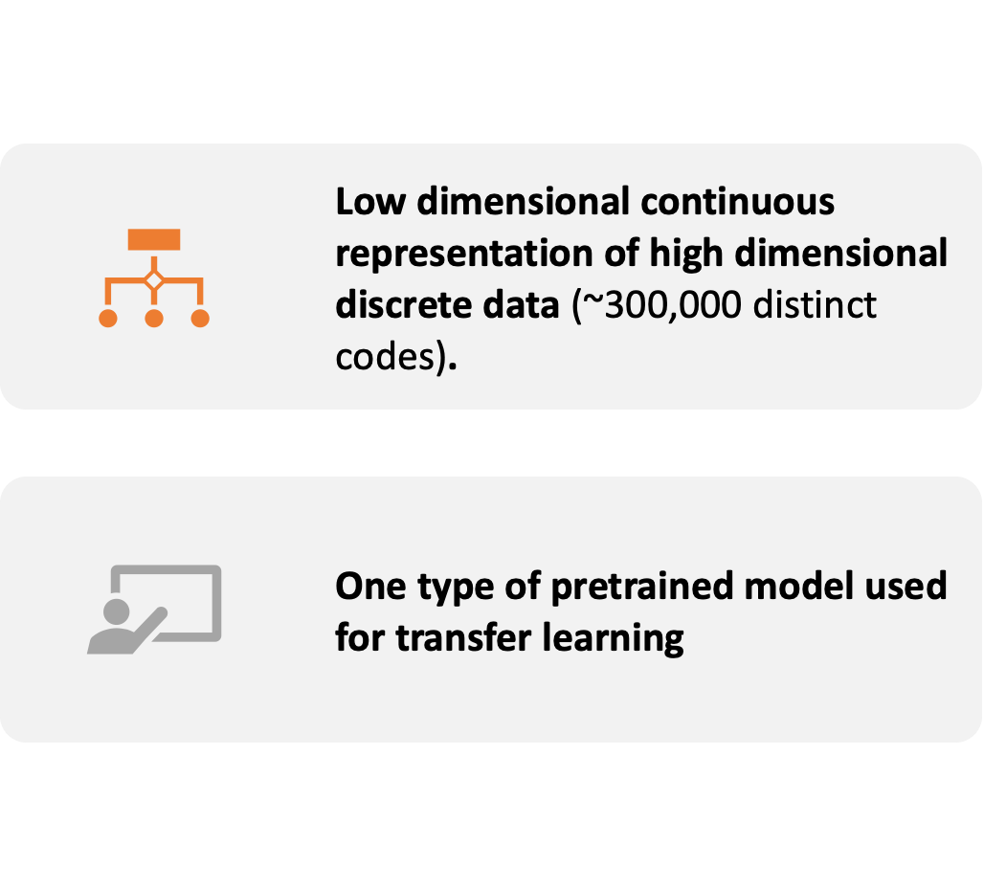
Clinical Concepts Embedding

Slide 16
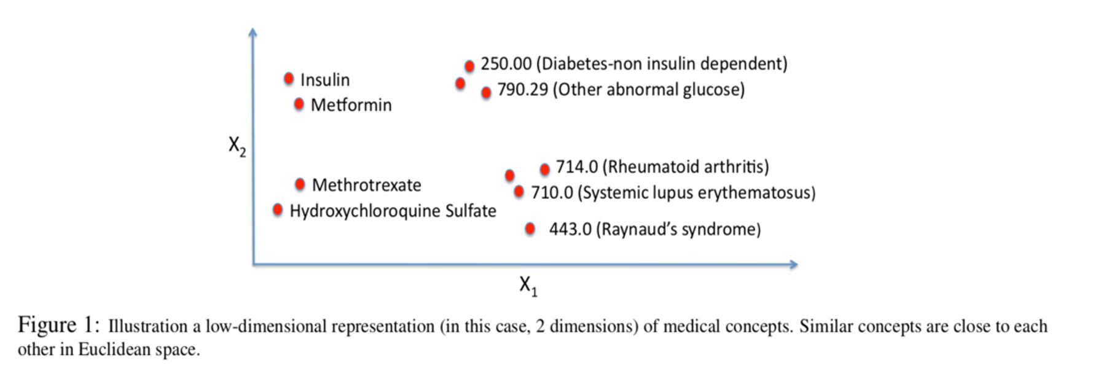
Clinical Concepts Embedding
Low-dimensional vector representations of medical concepts

Slide 17
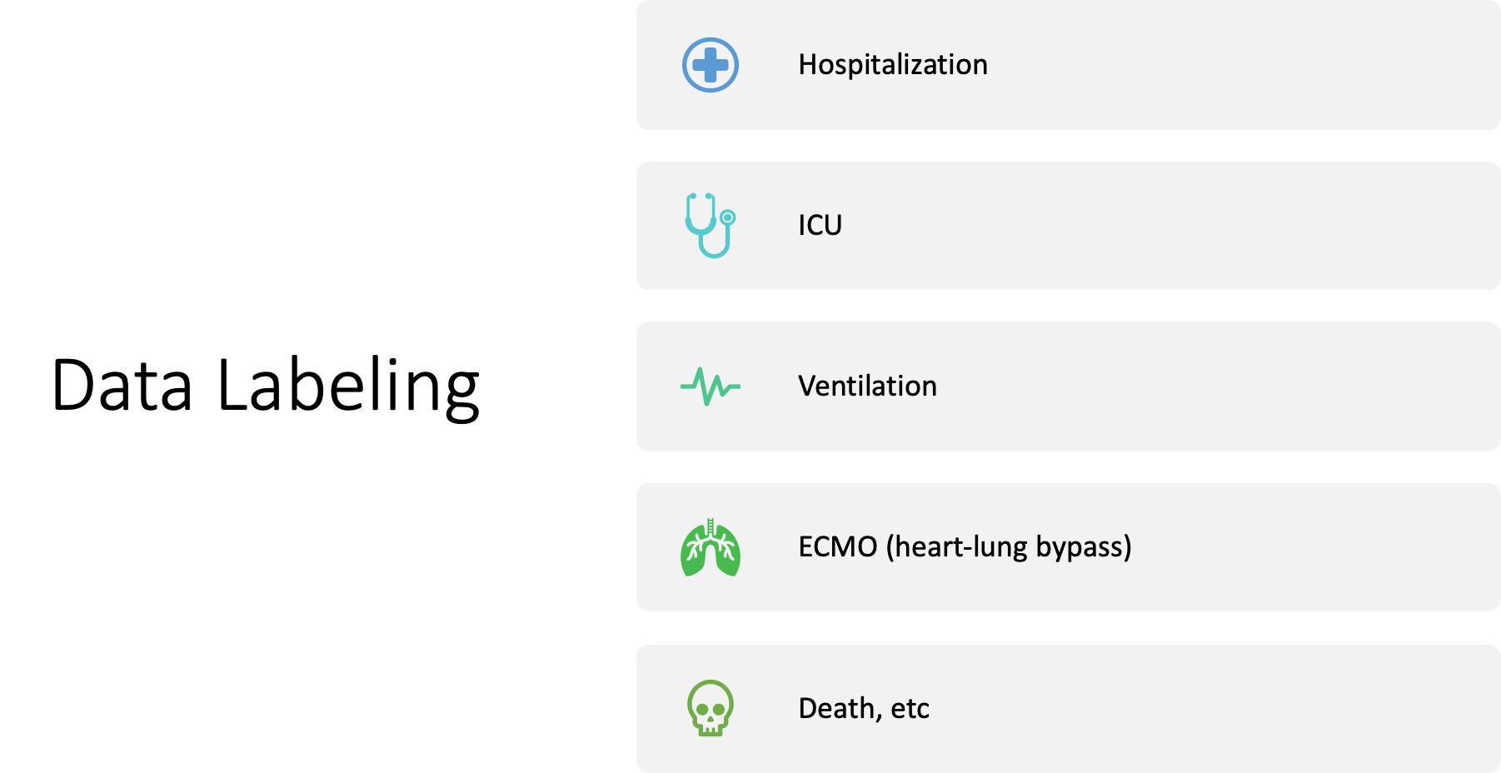
15.7%
6.5%
0.4%
0.01%
3.1%

Slide 18
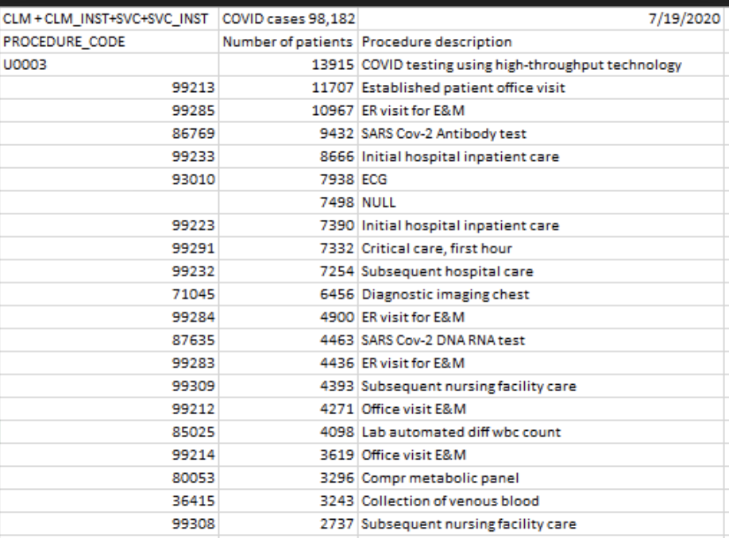
Top 20 Procedures for COVID Patients
Notes:
Excluding patients with immediate inpatient status or same day discharge.

Slide 19
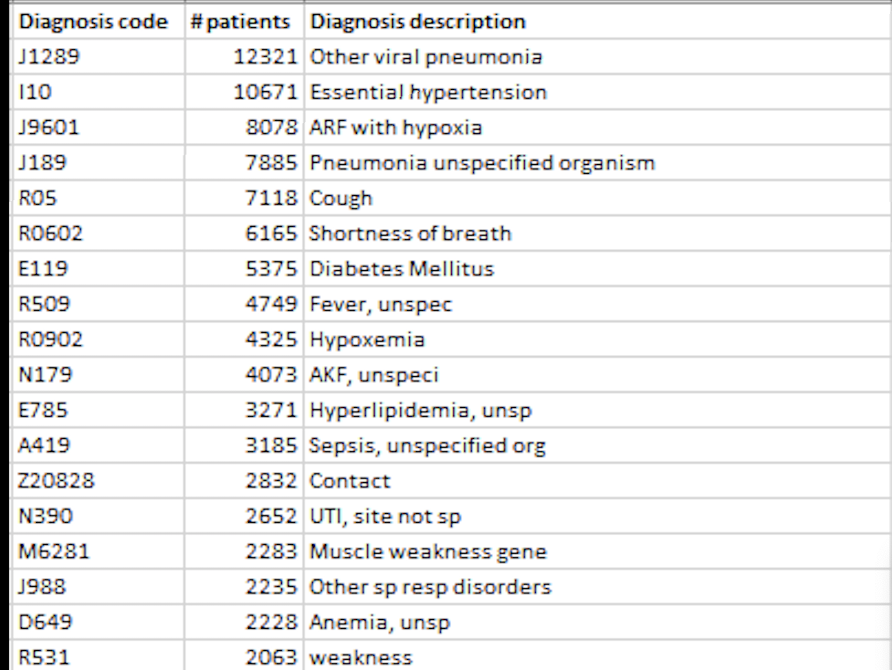
Top 20 Co-occurring Diagnosis with COVID-19
Notes:
Excluding patients with immediate inpatient status or same day discharge.

Slide 20
Baseline Prediction with Claims Data
Goal: Prediction of hospitalization for COVID-19 patient
Data:
Hand-crafted features (~100)
Total patients with COVID-19 infection: 170,241
Hospitalized patients: 17% of above
Train/Test/Validation set split: 60/20/20
Model:
Random Forest Classifier
Balanced weights
400 estimators with a max_depth of 20
algorithm, model performance, feature importance, future improvements
Notes:
Excluding patients with immediate inpatient status or same day discharge.

Slide 21
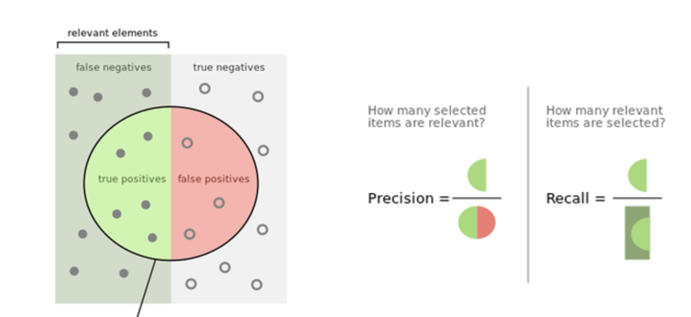
Precision & Recall Refresher
16%
Actually
Hospitalized
84%
Actually Not Hospitalized
FN
775
Minimize
TN
22727
TP
5026
FP
5531
Predicted Hospitalized
48%
87%
Notes:
Precision 48%, Recall at 87%

Slide 22
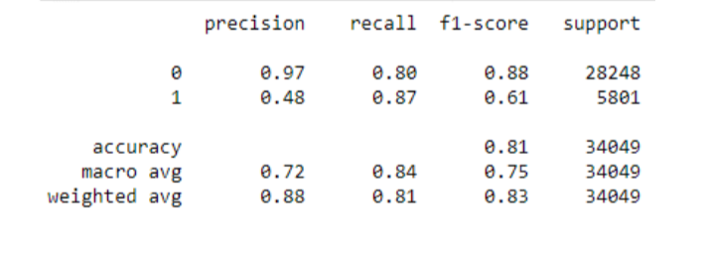
Hospitalization Results
Classification Report:
Notes:
Precision 48%, Recall at 87%

Slide 23
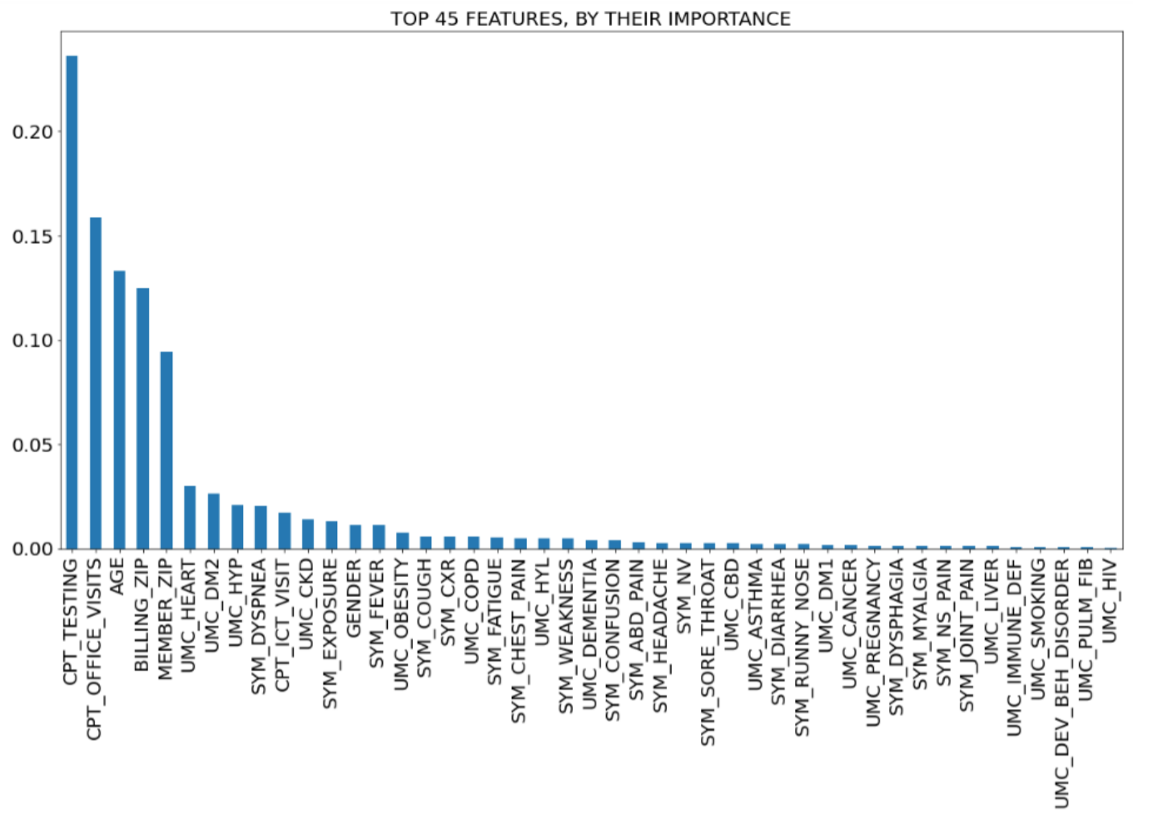
Notes:
Future improvements: 1) Clinical Embeddings 2) Deep Learning with temporal aspects of the claims.

Slide 24
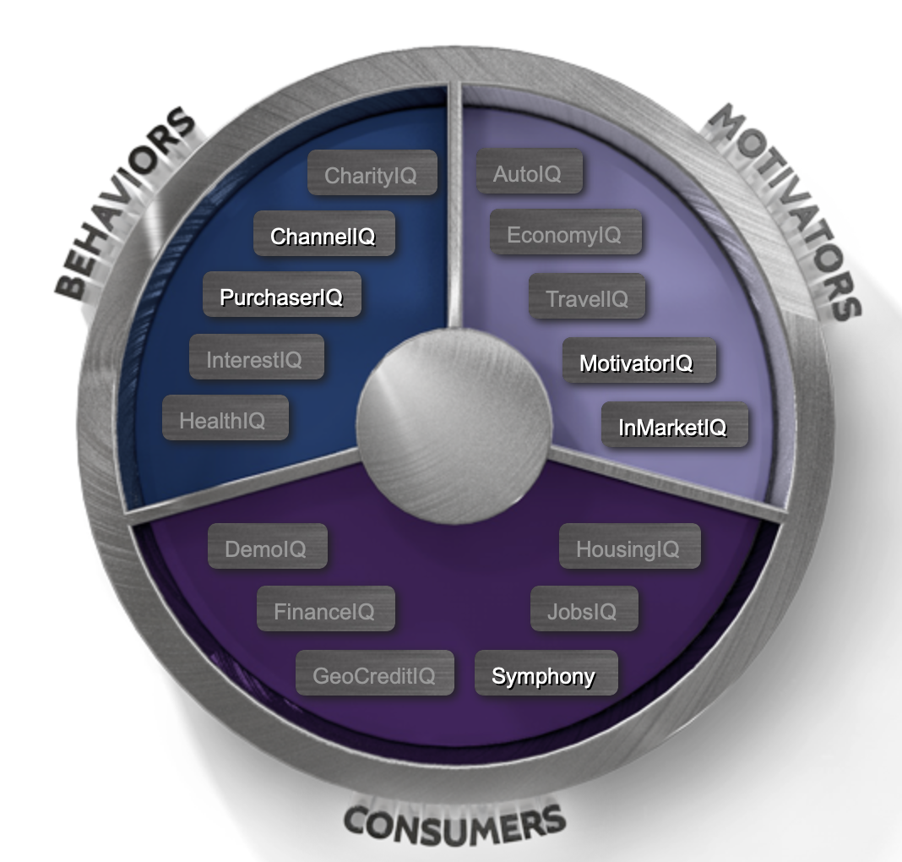
Social Determinants and Risk Factors
About 90 attributes of social data from Analytics IQ are available for over 34 million patients. Over 95,000 are COVID-19 patients.
We examined:
Impact of different demographics
Behaviors as risk factors
Predictors (likelihood) as risk factors

Slide 25
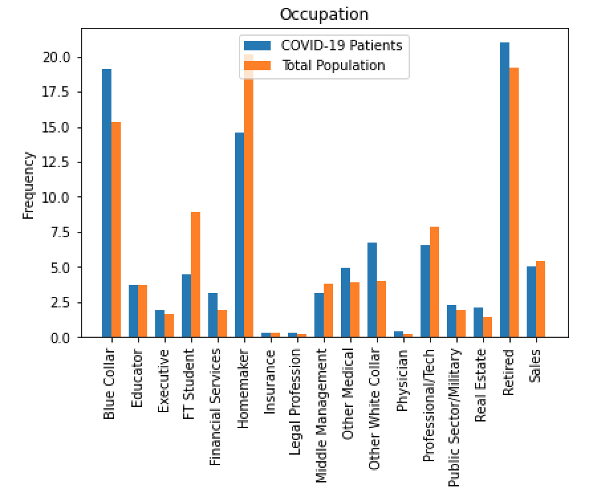
Occupation*
Notes:
JobsIQ = most likely occupation
Retired is a proxy for Age

Slide 26
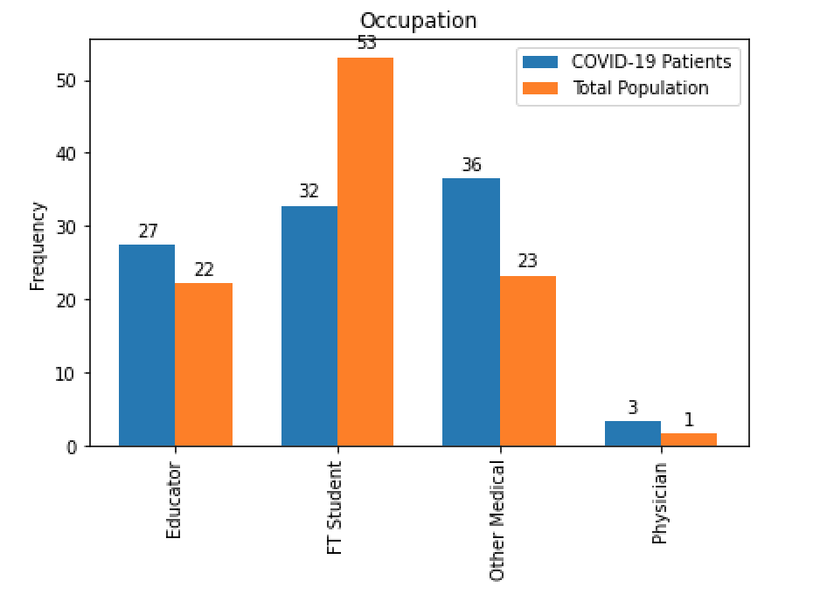
Specific Occupations

Slide 27
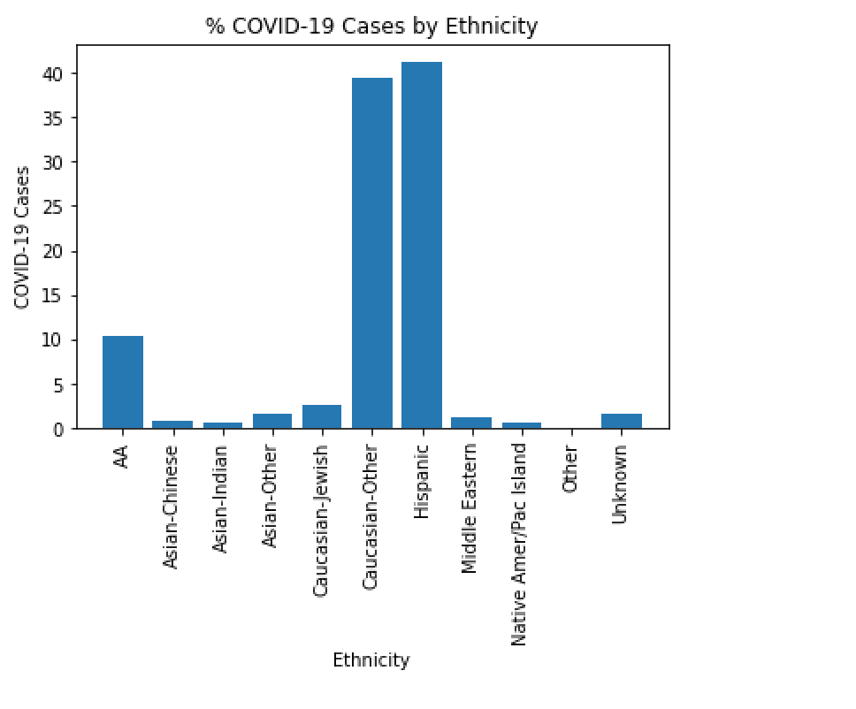
Ethnicity
Notes:
General Population
11% AA, 64% Caucasian, 13% Hispanic

Slide 28
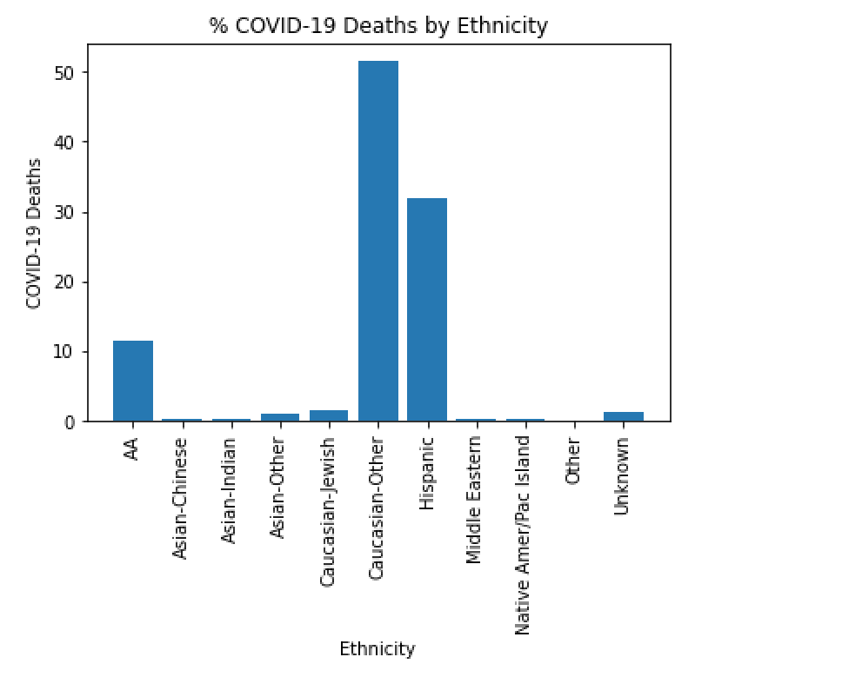
Ethnicity
Notes:
Don’t have cause of death

Slide 29
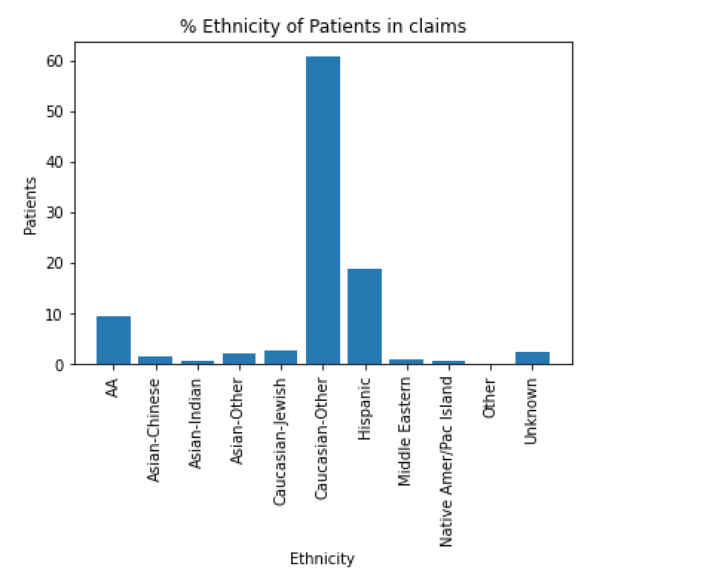
Ethnicity
Notes:
2019 claims
General Population: 11% AA, 64% Caucasian, 13% Hispanic

Slide 30
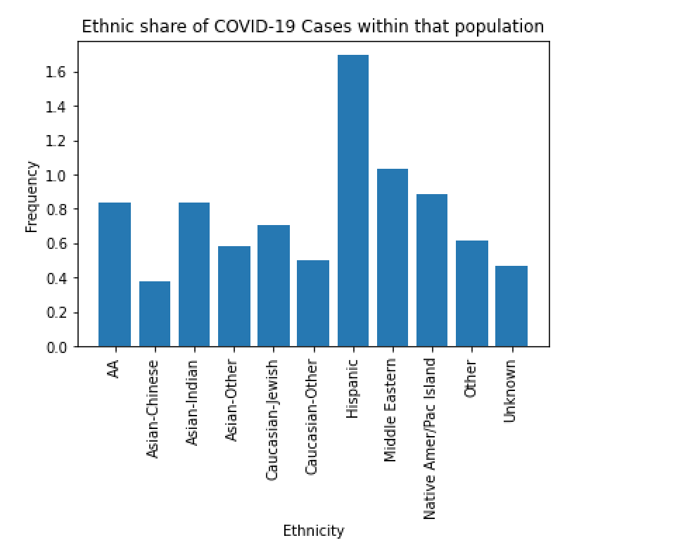
Ethnicity

Slide 31
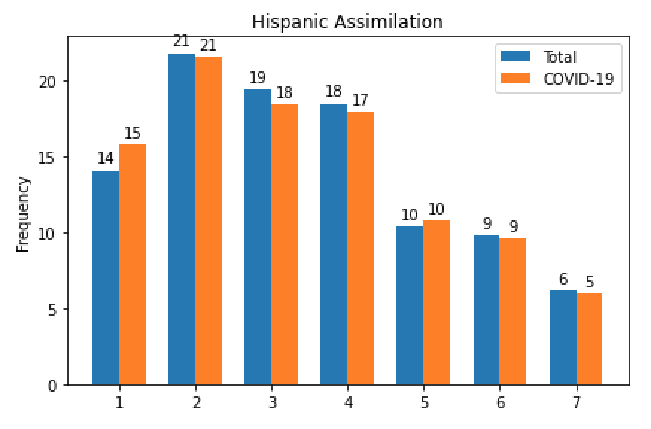
Assimilation into US Culture
Least likely Most likely
Notes:
Likelihood that Hispanic individual has assimilated to US culture. (1 least, 7 most)

Slide 32
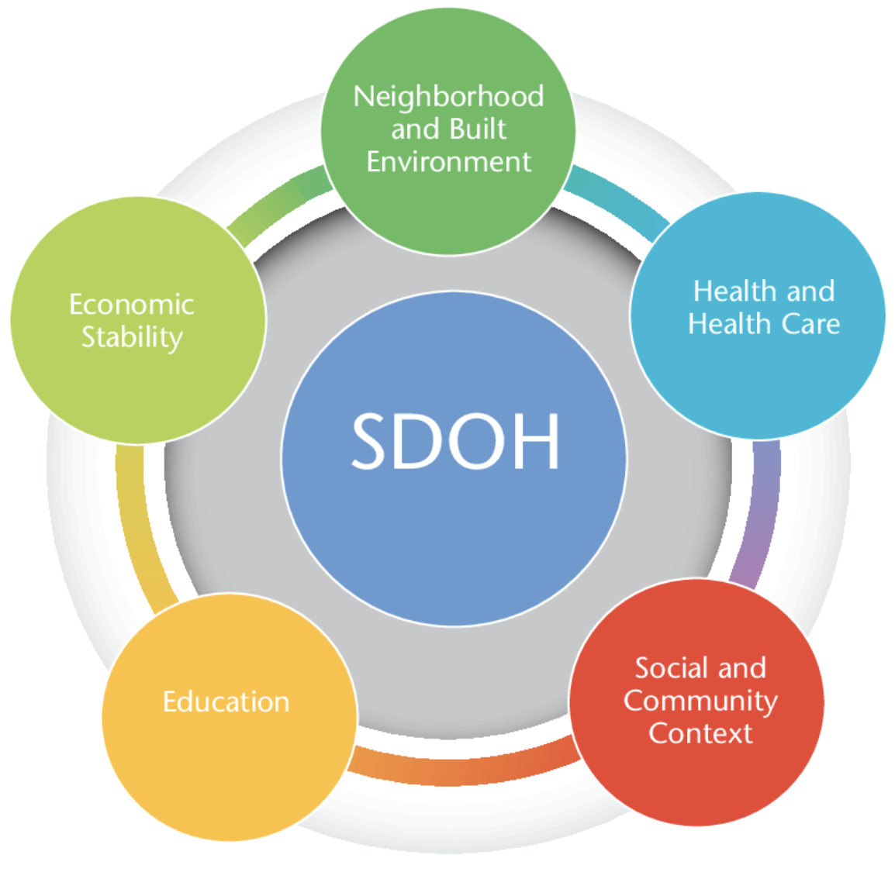
Future Work: SDOH
Many additional attributes available in the dataset:
BMI, Diet, Location, Profession, Access to Healthcare, Risky behavior, etc
Population Health study
Predictive Models
Personalized risk scoring

Slide 33
Future Work: Current Use Case
Improve model performance
Add clinical concept embeddings
Add temporal features (time sequence of clinical events)
Other machine learning and (lighter weight) deep learning models
Add more classification categories (other severe outcome types)
Incorporate Electronic Health Record data for prediction
Notes:
Precision 48%, Recall at 87%

Slide 34
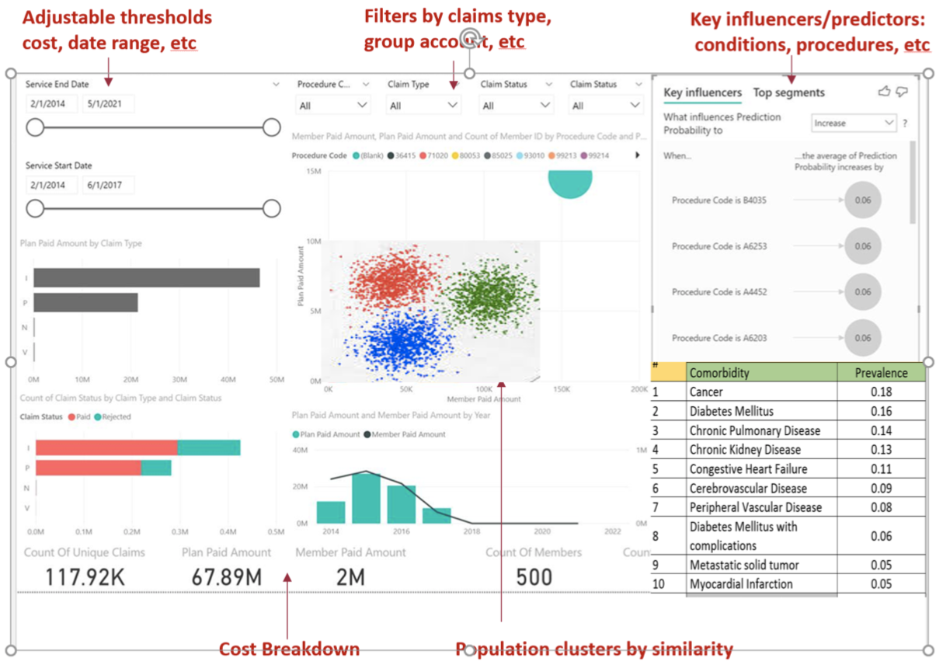
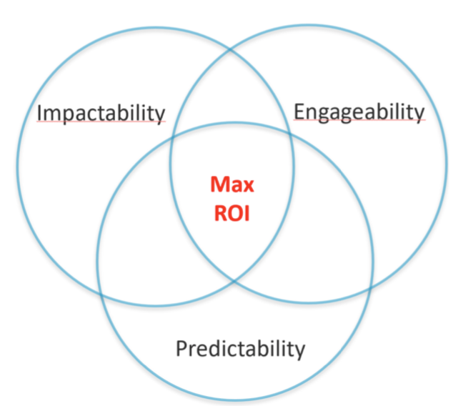
Future Work: Population Health Dashboard
Notes:
Precision 48%, Recall at 87%

Slide 35

Future Work: New Use Cases As the Pandemic Progresses
Drug and COVID-19 vaccine effectiveness and safety
Identify clinical trial candidates
Long term consequences of COVID-19
Personal
Societal
Health
Economical
Notes:
Precision 48%, Recall at 87%

Slide 36

Private AI
Collaborative
Learning with
Obfuscation
Aggregation &
Knowledge Transfer
Changrong Ji
David Patton, PhD
Vance Degen
Ben Carroll
Greg Ewing, JD
A3.AI

Slide 37
Data Sharing & Healthcare AI Challenges
Advanced analytics relies on data, often curated from multiple sources.
Data sharing and usage have a complex web of trust with multiple parties: data owners, analytics solutions providers and users.
Aggregating data and building models centrally raise concerns in
privacy and security,
single point of failure,
intellectual property and
misaligned incentives on the usage and value of of the combined data and models
CLOAK is a platform and toolkit that is under development to address some key challenges in collaborative privacy preserving machine learning.

Slide 38
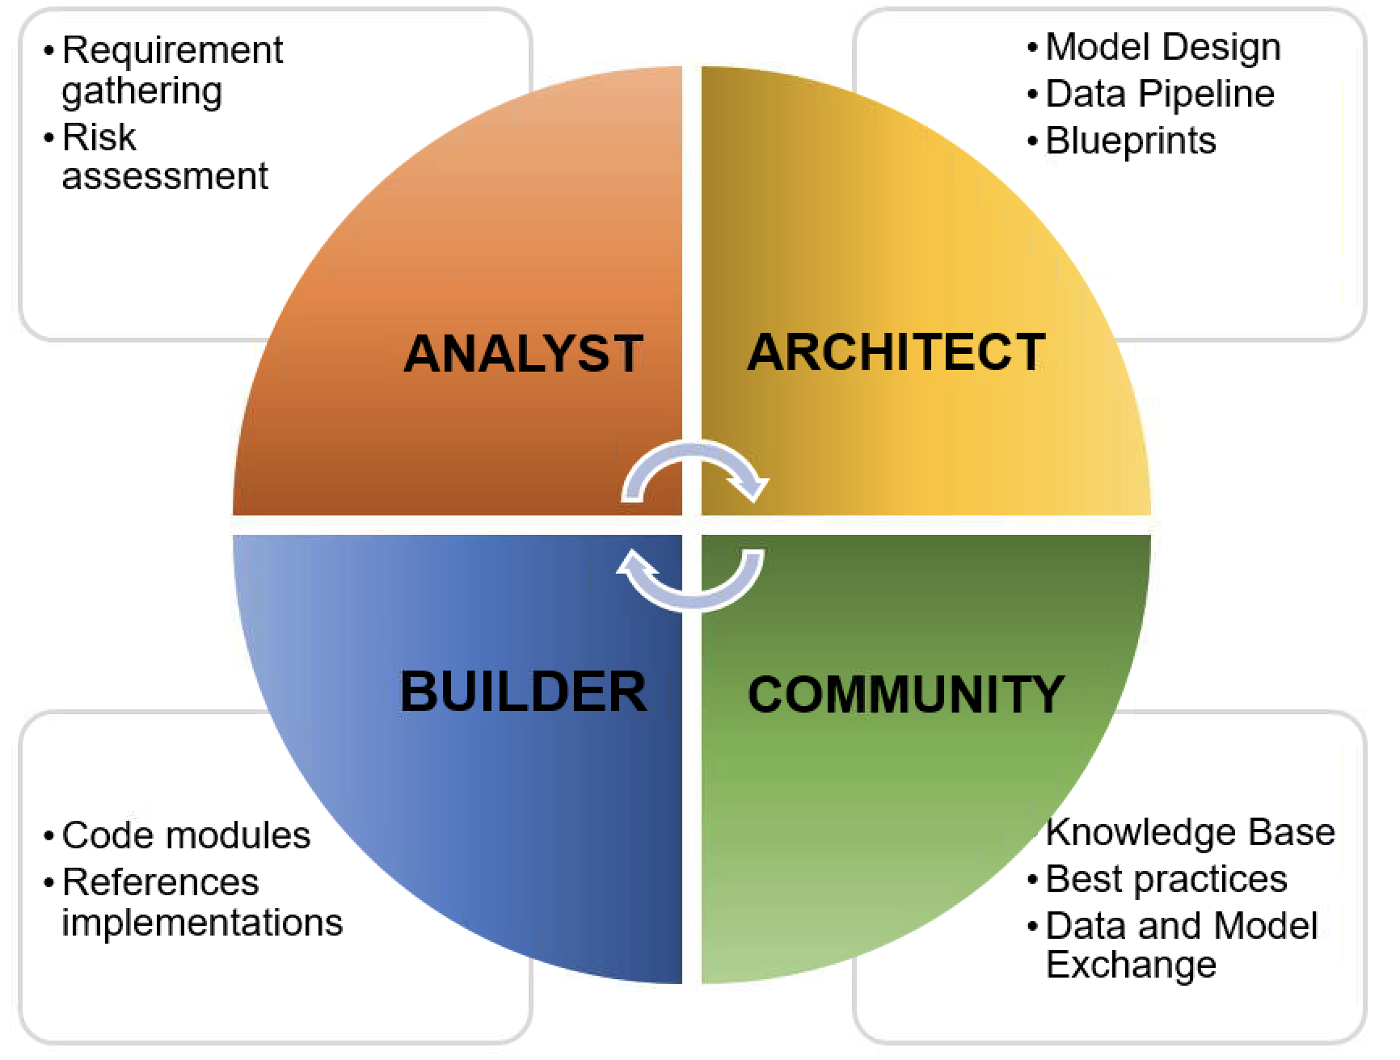
CLOAK PLATFORM (work in progress)
Copyright © 2020 Changrong Ji

Slide 39

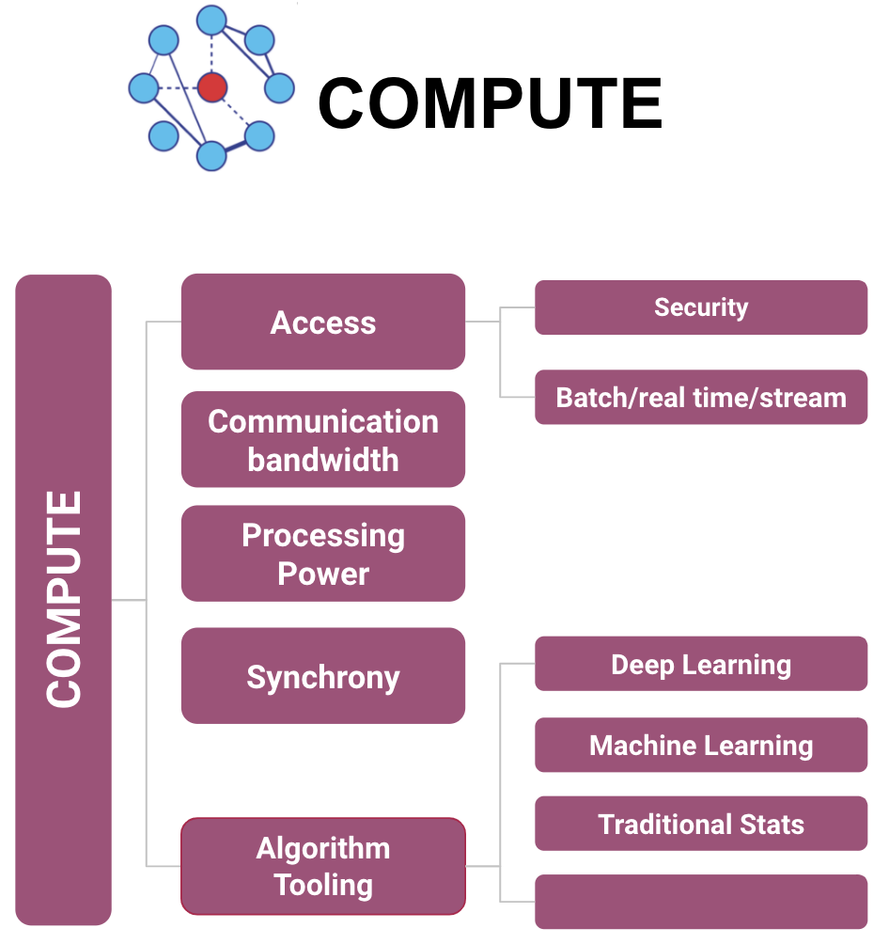
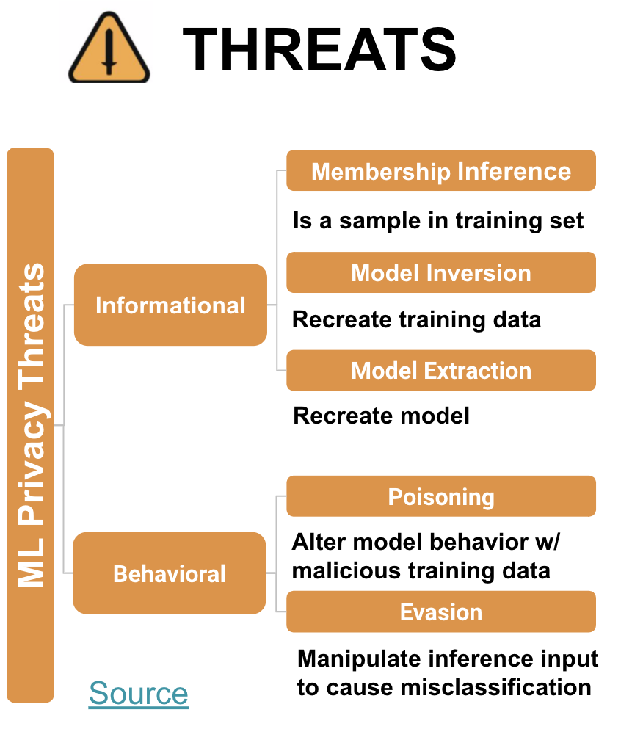
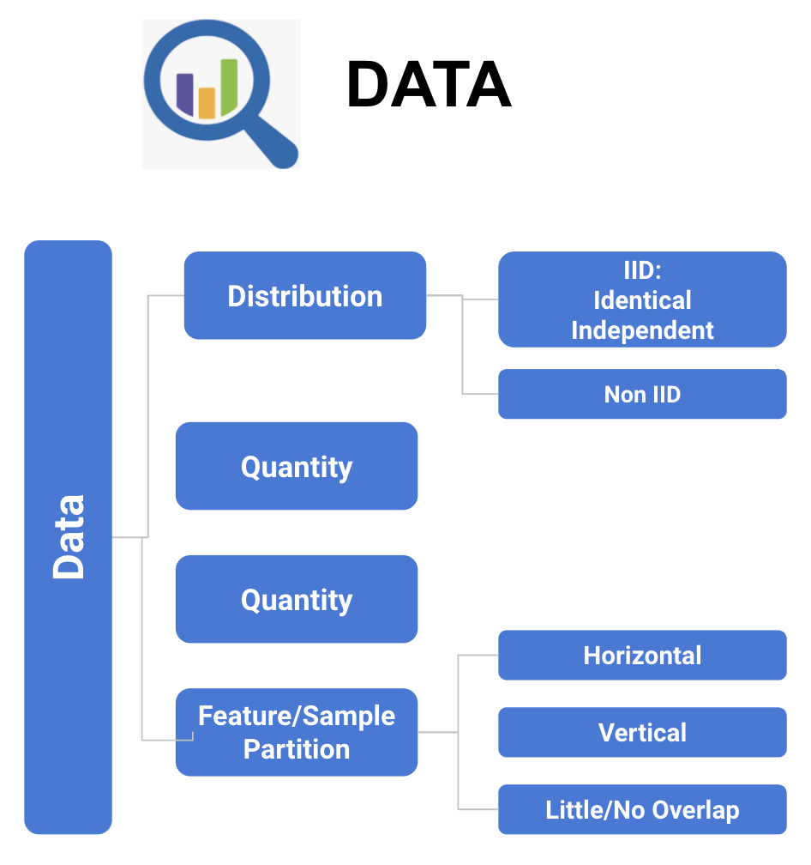
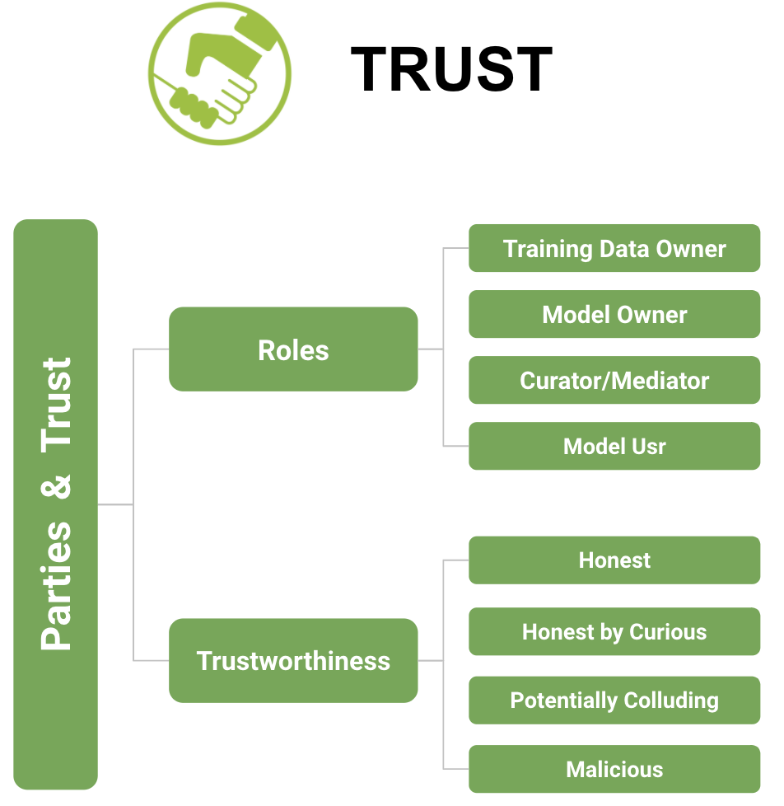
ANALYST
THREATS
COMPUTE
TRUST
DATA
Copyright © 2020 Changrong Ji

Slide 40
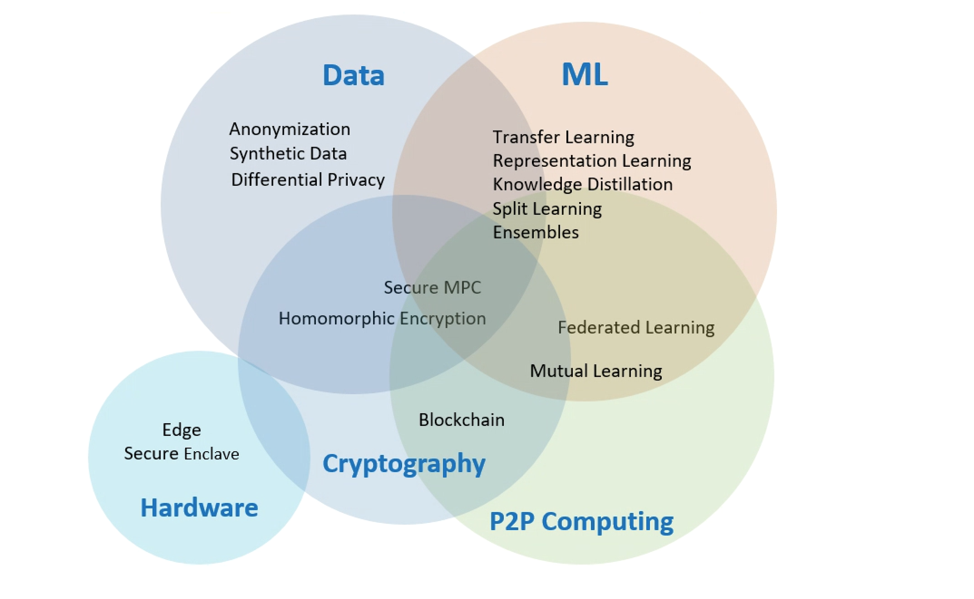
PRIVACY PRESERVING TECHNIQUES 2020
Copyright © 2020 Changrong Ji

Slide 41
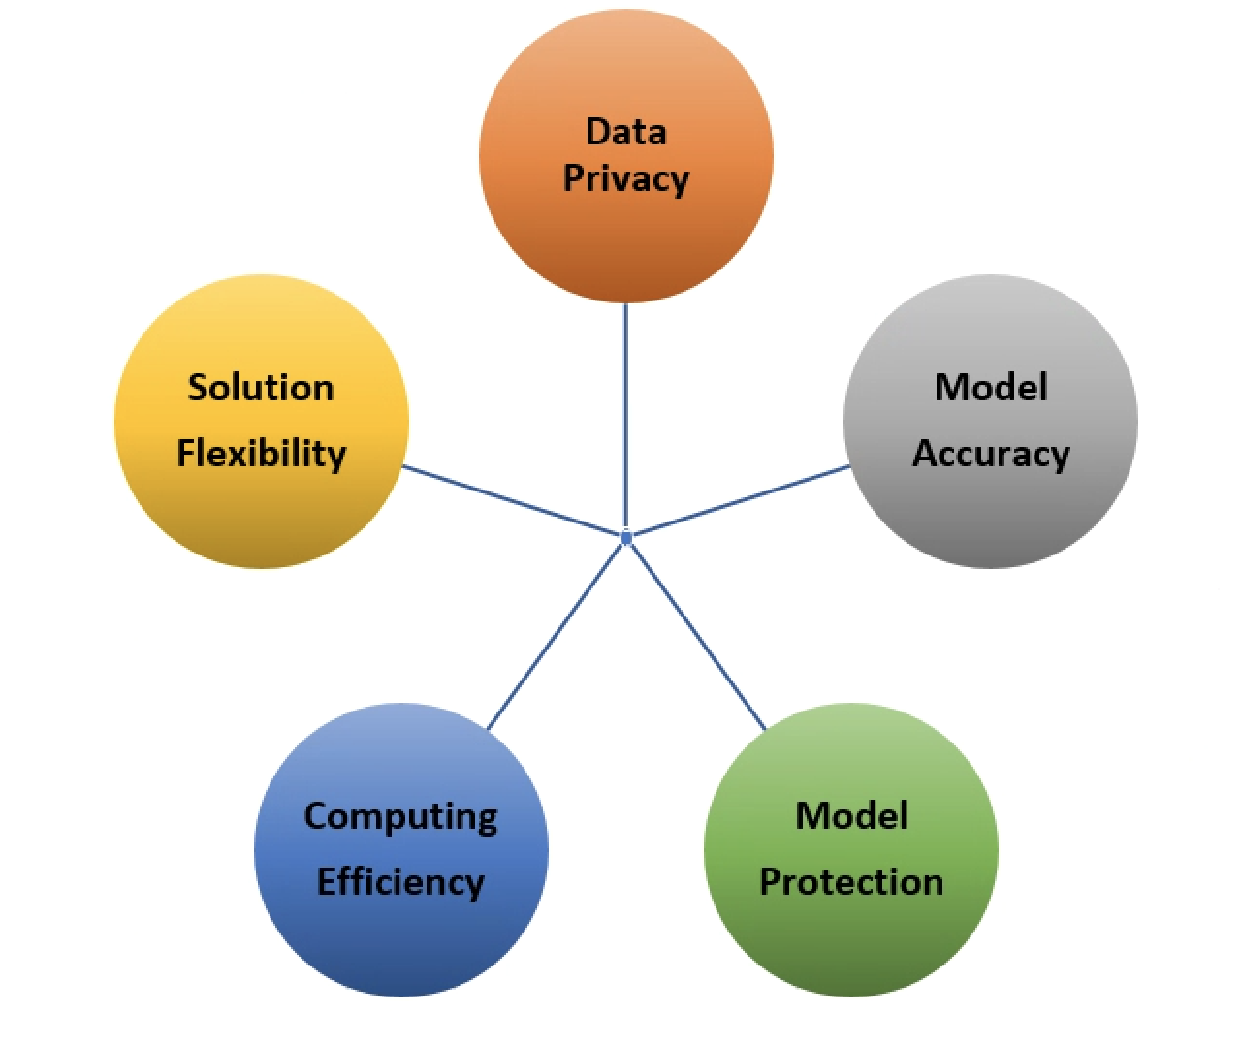
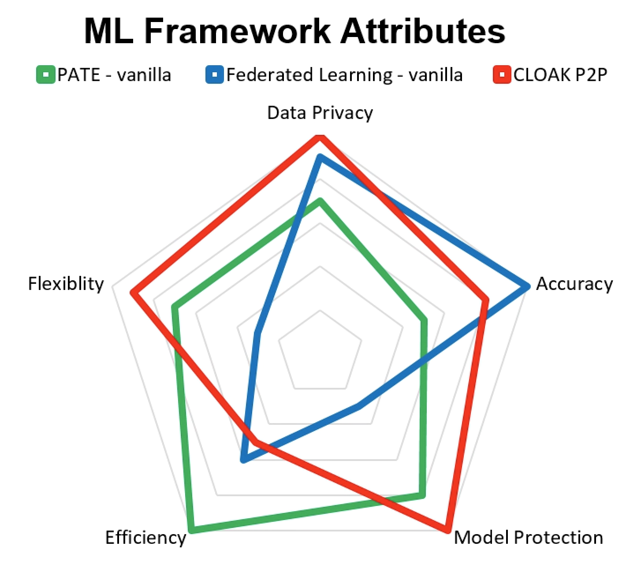
ARCHITECT
Copyright © 2020 Changrong Ji
DESIGN TRADE-OFFS
EXAMPLES

Slide 42
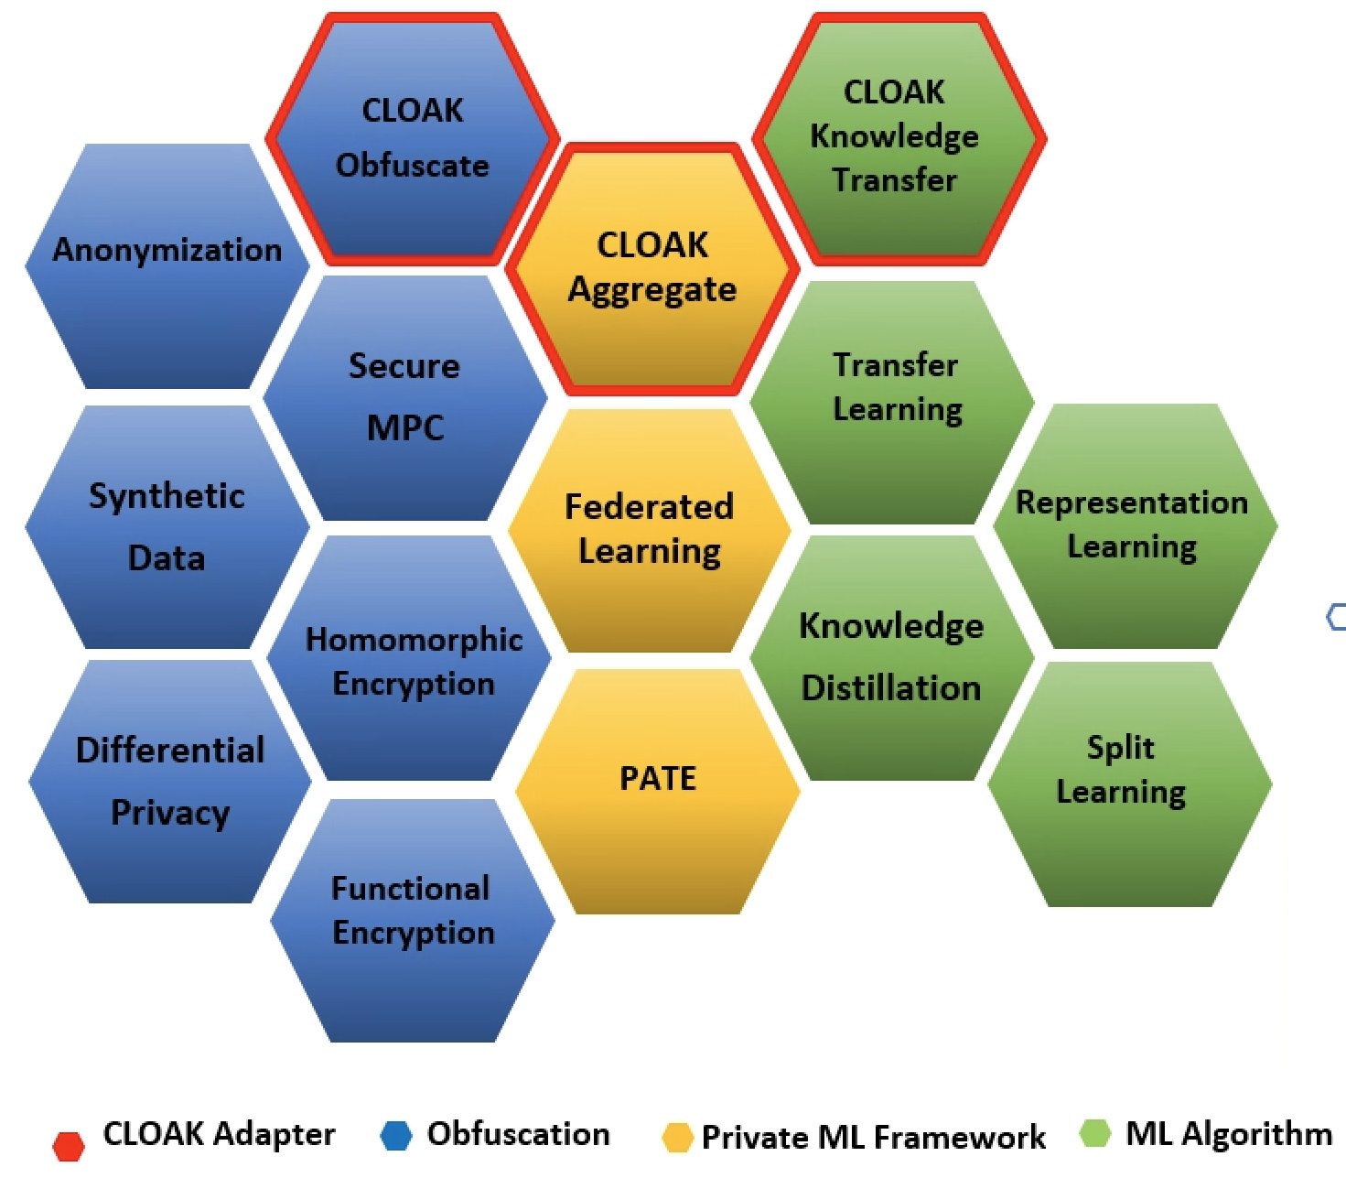
BUILDER
Copyright © 2020 Changrong Ji

